Slide 1


Name : Mohamed Fathy Solimanm
Gmail : mohammedandfathy23@gmail.com.
Phone : 01016142975.

Slide 2
Bussines Requirements :
Functional: The solution meets the functional requirements, such as the ability to view, add, delete, or modify the student records, without any perceivable delay.
Load balanced: The solution can properly balance user traffic to avoid overloaded or underutilized resources.
Scalable: The solution is designed to scale to meet the demands that are placed on the application.
Highly available: The solution is designed to have limited downtime when a web server becomes unavailable.
Secure:
The database is secured and can’t be accessed directly from public networks.
The web servers and database can be accessed only over the appropriate ports.
The web application is accessible over the internet.
High performing: The routine operations (viewing, adding, deleting, or modifying records) are performed without a perceivable delay under normal, variable, and peak loads.

Slide 3
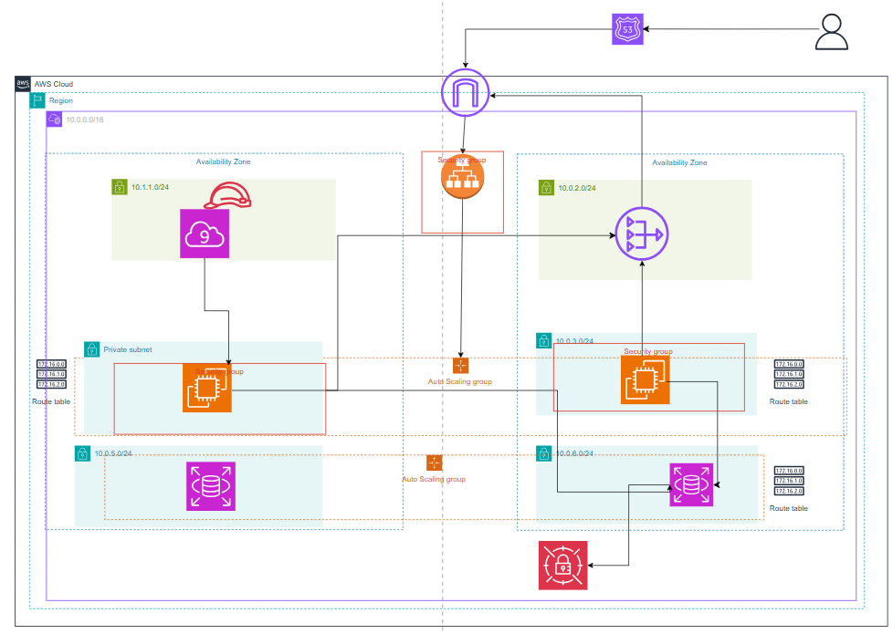
Archeticture :

Slide 4
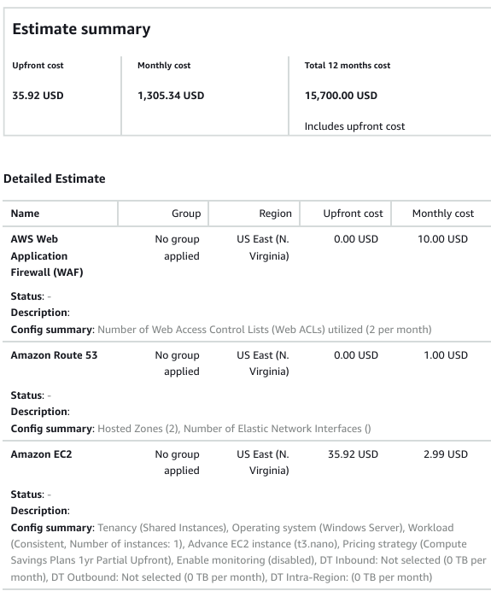
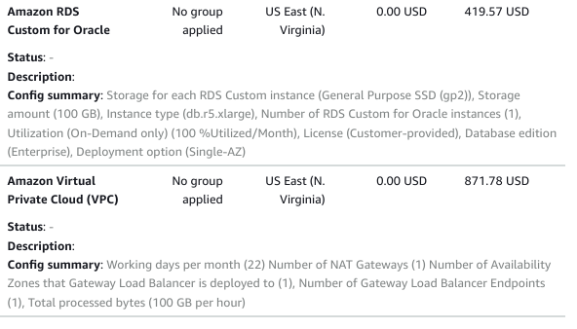
Cost

Slide 5




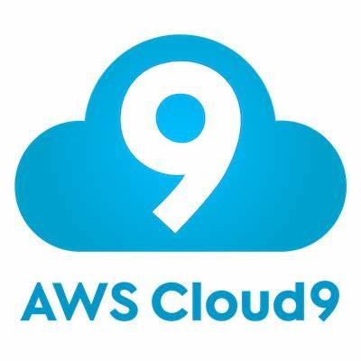


Aws icons :
AMAZON RDS
EC2 instance
Auto scaling group
Secrets manager
Application load balancer
VPC
Aws Cloud 9

Slide 6
Aws resources icons [RDS]
Rds : is a managed relational database service provided by AWS. It simplifies the setup, operation, and scaling of relational databases in the cloud. With RDS, you can deploy several popular database engines.

Slide 7

Aws resources icons [EC2]
EC2 instance : Amazon Elastic Compute Cloud (Amazon EC2) provides on-demand, scalable computing capacity in the Amazon Web Services (AWS) Cloud. Using Amazon EC2 reduces hardware costs so you can develop and deploy applications faster. You can use Amazon EC2 to launch as many or as few virtual servers as you need.

Slide 8


Aws resources icons[secrets manager , LB].
AWS Secrets Manager is a fully managed service that helps you securely store, manage, and retrieve sensitive information like database credentials.
Aws Application load balancer: automatically distributes incoming traffic across multiple targets, such as EC2 instances

Slide 9

Aws resources icons [VPC , Cloud9]
VPC : service that allows you to create an isolated network within the AWS cloud, where you can launch and manage AWS resources like EC2 instances, RDS databases.
cloud-based integrated development environment (IDE) that allows you to write, run, and debug code using just a web browser.

Slide 10
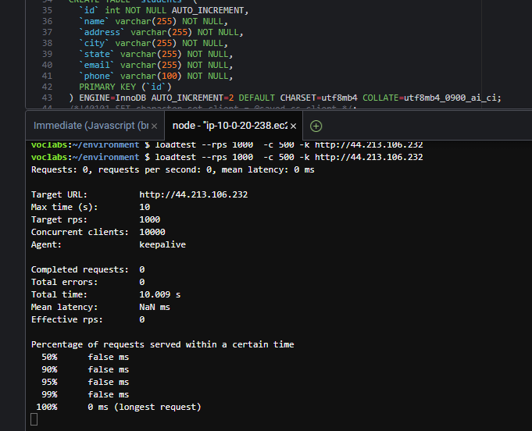
Cloud9 with loadTest function

Slide 11
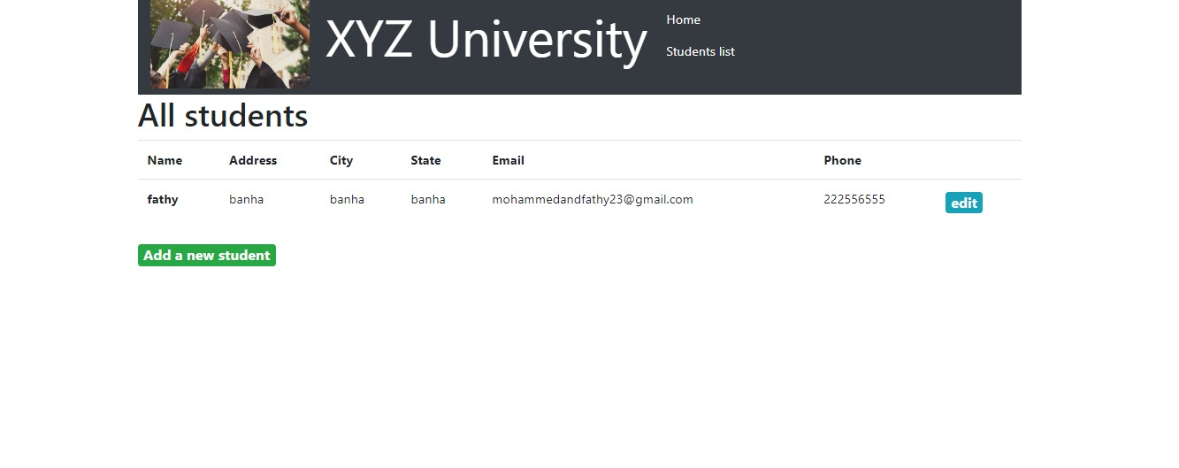
Final Application output

